Slide 1

Surveillance Technology Public Comment Meeting
Seattle Police Department

Slide 2
Public Records Act Notice
This meeting is being recorded and will be posted online
Information provided (including public comments) to the City of Seattle is considered a public record and may be subject to public disclosure. For more information see the Public Records Act, RCW Chapter 42.56.

Slide 3

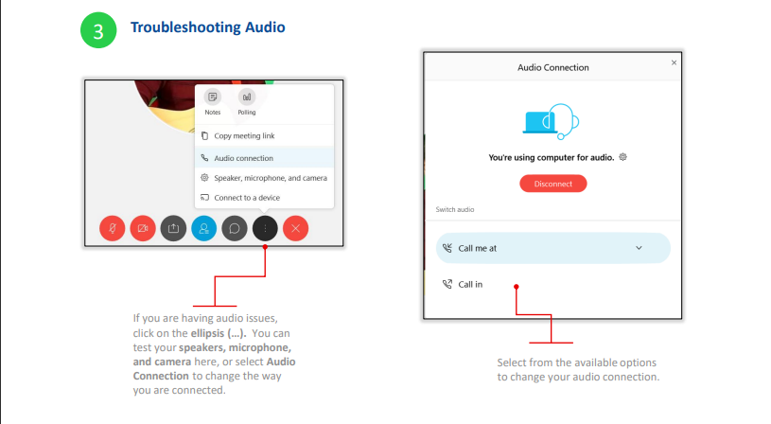
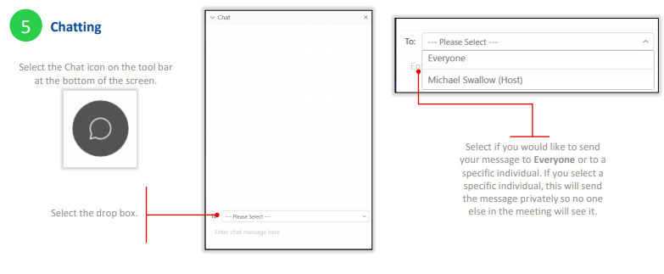
WebEx Basics

Slide 4
WebEx Basics
For Dial-In Attendees
Once the meeting starts, if you have a question, press “*3” to raise your hand. Once you have raised your hand, you'll hear the prompt, "You have raised your hand to ask a question. Please wait to speak until the host calls on you."
To hear a list of commands available during your meeting or event, press “**”.
If you no longer want to ask a question, or the host has already called on you, then press “*3” to lower your hand. You will hear a message, "You have lowered your hand".

Slide 5
Ground Rules
Attendees will be asked to adhere to the surveillance public meeting code of conduct:
Be respectful of diverse opinions and experiences.
Be an active listener during presentations.
Anyone exhibiting disruptive behavior, intimidation or aggression, may be muted. If so, they will be asked to provide comment online or by letter.
Please keep comments as brief as possible and related to technologies in focus to allow everyone an opportunity to speak.

Slide 6
City of Seattle’s Definition of Surveillance
Surveillance is defined as technologies that "observe or analyze the movements, behavior, or actions of identifiable individuals in a manner that is reasonably likely to raise concerns about civil liberties, freedom of speech or association, racial equity or social justice."
Certain technologies, such as police body cameras and technologies for everyday office use, are excluded from the law.

Slide 7
How to Comment on Technologies
Survey Link: https://seattle.surveymonkey.com/r/BPF6GKM
Mail a comment to Surveillance & Privacy Program:
Seattle IT
PO Box 94709
Seattle, WA 98124

Slide 8
Rundown of Events
SPD will present on technologies currently in use
  Camera systems
  Tracking Devices
  Remotely Operated Vehicles (ROVs)
  GeoTime
  Computer, cellphone and mobile device extraction tools
  Crash Data Retrieval
Public Dialog Opportunity

Slide 9
Additional Comments
For additional comments unrelated to these specific surveillance technologies, please utilize the following resources:
Find Your Council District / Councilmember
  Contact City Council at council@seattle.gov
SPD Contact Information

Slide 10
Group 4b Technologies
Seattle Police Department

Slide 11
Seattle Police Department Mission
Prevent crime;
Enforce the law; and
Support quality public safety by delivering respectful, professional and dependable police services.

Slide 12
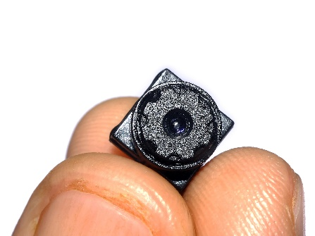
Camera Systems
What is the technology?
  SPD’s covert camera systems capture images and video of identifiable individuals, some of whom are unaware of the recording.
  Covert cameras can be concealed on a person or hidden in or on objects within a particular environment. These cameras capture images only, they do not record sound.

Slide 13
Camera Systems
Why does SPD use the technology?
  Covert camera systems are used by the Seattle Police Department (SPD) to obtain information during criminal investigations. These cameras are disguised and used to record specific events related to an investigation.

Slide 14
Camera Systems
Data Collection
  When reasonable suspicion of criminal activity exists, cameras may be placed to capture plain view events in areas where no reasonable expectation of privacy exists.
  When placed in areas where a reasonable expectation of privacy exists, use of the camera systems is pursuant to the Washington Privacy Act, Chapt.9.73 RCW, and are utilized only after obtaining appropriate consent and/or legal search warrant authority.

Slide 15
Camera Systems
Protections
  All deployments of these devices are documented by TESU and subject to audit by the Office of Inspector General and the federal monitor at any time.
  All information must be gathered and recorded in a manner that is consistent with SPD Policy 6.060, such that it does not reasonably infringe upon “individual rights, liberties, and freedoms secured by the Constitution of the United States and of the State of Washington, including, among others, the freedom of speech, press, association and assembly; liberty of conscience; the exercise of religion; and the right to petition government for redress of grievances; or violate an individual’s right to privacy.”

Slide 16
Camera Systems
Related Policies
  Washington Privacy Act, Chapt.9.73 RCW
  Washington Public Records Act, Chapter 42.56 RCW
  WAC 446-20-260
  RCW 10.97.030
  8 CFR Part 20
  SPD Policy 5.001 - Standards and Duties
  SPD Policy 5.002 - Responsibilities of Employees Concerning Alleged Policy Violations
  SPD Policy 5.140 - Bias-Free Policing
  SPD Policy 6.060 - Collection of Information for Law Enforcement Purposes
  SPD Policy 7.010 – Submitting Evidence
  SPD Policy 12.040 - Department-Owned Computers, Devices & Software
  SPD Policy 12.050 - Criminal Justice Information Systems
  SPD Policy 12.080 – Department Records Access, Inspection & Dissemination
  SPD Policy 12.110 – Use of Department E-mail & Internet Systems
  SPD Policy 12.111 – Use of Cloud Storage Services

Slide 17

Tracking Devices
What is the technology?
  Geolocation trackers are cellular devices that SPD utilizes as a tool to locate and track the movements and locations of vehicles.
  These trackers are location tracking devices that report latitude and longitude as well as other device information such as high temperature alerts, device removal, power/shut down alerts, and battery level.

Slide 18
Tracking Devices
Why does SPD use the technology?
  The primary benefit of these tracking systems is in the gathering of evidence used in the resolution of criminal investigations. Proper gathering of location evidence of criminal activity by the police supports SPD’s mission to prevent crime, enforce the law, and support quality public safety.
  Trackers allow SPD to remotely track vehicles electronically. They also allow SPD to locate vehicles and individuals that are sought in connection with an active investigation. They are only utilized with consent of a witness, a confidential informant, or within the scope of a judicially issued search warrant.

Slide 19
Tracking Devices
Data Collection
  Tracking devices are only utilized with express consent or search warrant authority. These devices report latitude and longitude coordinates on a pre-determined schedule that can be adjusted by users remotely.
  Data collected from the tracking devices is provided to the requesting Officer/Detective for inclusion in the investigation file and is stored following evidence guidelines.

Slide 20
Tracking Devices
Protections
  All deployments of these devices are documented by TESU and subject to audit by the Office of Inspector General and the federal monitor at any time.
  All information must be gathered and recorded in a manner that is consistent with SPD Policy 6.060, such that it does not reasonably infringe upon “individual rights, liberties, and freedoms secured by the Constitution of the United States and of the State of Washington, including, among others, the freedom of speech, press, association and assembly; liberty of conscience; the exercise of religion; and the right to petition government for redress of grievances; or violate an individual’s right to privacy.”

Slide 21
Tracking Devices
Related Policies
  Washington Privacy Act, Chapt.9.73 RCW
  Washington Public Records Act, Chapter 42.56 RCW (“PRA”)
  GS2016-009 - Washington State Retention Schedule for Records Documented
  SMC 14.12
  SPD Policy 5.001 - Standards and Duties
  SPD Policy 5.002 - Responsibilities of Employees Concerning Alleged Policy Violations
  SPD Policy 5.140 - Bias-Free Policing
  SPD Policy 6.060 - Collection of Information for Law Enforcement Purposes
  SPD Policy 7.010 – Submitting Evidence
  SPD Policy 12.040 - Department-Owned Computers, Devices & Software
  SPD Policy 12.050 - Criminal Justice Information Systems
  SPD Policy 12.055 - Criminal Justice Research
  SPD Policy 12.080 – Department Records Access, Inspection & Dissemination
  SPD Policy 12.110 – Use of Department E-mail & Internet Systems
  SPD Policy 12.111 – Use of Cloud Storage Services

Slide 22
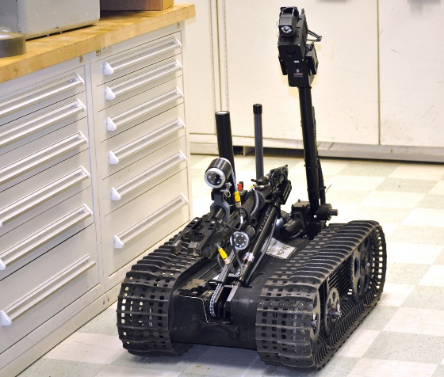
Remotely Operated Vehicles (ROVs)
What is the technology?
  Remotely Operated Vehicles (ROVs) are unarmed remote controlled vehicles utilized by SPD SWAT, Arson/Bomb, and Harbor units to access areas that are potentially dangerous for personnel to physically enter.
  All SPD ROVs are controlled by SPD employees operating handheld controllers from a safe position nearby. Some ROVs operated by SPD have a remotely controlled arm capable of performing simple tasks safely from a remote location.

Slide 23
Remotely Operated Vehicles (ROVs)
Why does SPD use the technology?
  The use of ROVs allows tactical units to assess potentially dangerous situations from a safe position. By entering an environment with the additional information obtained using remote cameras, or having rendered-safe a suspicious package, SPD personnel and community members are safer.
  The Harbor unit utilizes the ROVs to perform necessary underwater search and recovery functions that would not be possible with manned diving alone.

Slide 24
Remotely Operated Vehicles (ROVs)
Data Collection
  No images or data are stored or retained by ROVs used by the SWAT or Arson/Bomb units. The Harbor unit ROVs store video and sonar imagery captured during each deployment of the unit.
  Only images directly related to the specific search and recovery are manually exported from the ROV’s onboard hard drive if requested by SPD detectives for follow up investigation.

Slide 25
Remotely Operated Vehicles (ROVs)
Protections
  There is no legal standard or condition for the use of these ROVs in non-protected public areas, such as a hotel hallway or public waterway.
  However, if the use of the ROV is to occur inside a protected area, such as in a person’s home or property, absent exigent circumstances, or consent, a signed warrant is obtained from a judge.

Slide 26
Remotely Operated Vehicles (ROVs)
Related Policies
  Washington Privacy Act, Chapt.9.73 RCW
  Washington Public Records Act, Chapter 42.56 RCW
  WAC 446-20-260
  RCW 10.97.030
  8 CFR Part 20
  5.001 - Standards and Duties
  5.002 - Responsibilities of Employees Concerning Alleged Policy Violations
  5.140 - Bias-Free Policing
  6.060 - Collection of Information for Law Enforcement Purposes
  SPD Policy 7.010 – Submitting Evidence
  SPD Policy 12.040 - Department-Owned Computers, Devices & Software
  SPD Policy 12.050 - Criminal Justice Information Systems
  SPD Policy 12.055 - Criminal Justice Research
  SPD Policy 12.080 – Department Records Access, Inspection & Dissemination
  SPD Policy 12.110 – Use of Department E-mail & Internet Systems
  SPD Policy 12.111 – Use of Cloud Storage Services

Slide 27
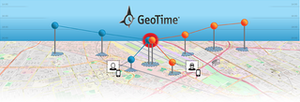
GeoTime
What is the technology?
  GeoTime is geospatial analysis software that allows the visual analysis of events over time. Utilizing geodata, such as latitude and longitude, procured during criminal investigations, investigators use GeoTime to create specialized 2 and 3 dimensional maps of call records and cell site locations.
  These maps allow investigators to see patterns in the existing data that might not be interpreted through other methods.

Slide 28
GeoTime
Why does SPD use the technology?
  Visualizing criminal information provides investigators a more thorough understanding of complicated criminal investigations.
  GeoTime reduces the time and effort required of investigators to analyze large amounts of data which translates into a better and more efficient work product.

Slide 29
GeoTime
Data Collection
  GeoTime does not collect information or data. It is a tool used to aggregate and analyze data manually input by investigators and exports complex geospatial maps which users save into locally stored investigation files. No information is saved inside the GeoTime tool.

Slide 30
GeoTime
Protections
  GeoTime is only used during the investigation of crimes by the SPD.
  All use of GeoTime must also comply with SPD Policy 12.050 – Criminal Justice Information Systems and may only be used for legitimate criminal investigative purposes.
  Use of GeoTime is governed by the City of Seattle Intelligence Ordinance, 28 CFR Part 23, CJIS requirements, and any future applicable requirements.

Slide 31
GeoTime
Related Policies
  Washington Privacy Act, Chapt.9.73 RCW
  Washington Public Records Act, Chapter 42.56 RCW (“PRA”)
  WAC 446-20-260
  RCW 10.97.030
  8 CFR Part 20
  5.001 - Standards and Duties
  5.002 - Responsibilities of Employees Concerning Alleged Policy Violations
  5.140 - Bias-Free Policing
  6.060 - Collection of Information for Law Enforcement Purposes
  SPD Policy 7.010 – Submitting Evidence
  SPD Policy 12.040 - Department-Owned Computers, Devices & Software
  SPD Policy 12.050 - Criminal Justice Information Systems
  SPD Policy 12.055 - Criminal Justice Research
  SPD Policy 12.080 – Department Records Access, Inspection & Dissemination
  SPD Policy 12.110 – Use of Department E-mail & Internet Systems
  SPD Policy 12.111 – Use of Cloud Storage Services

Slide 32

Computer, cellphone and mobile device extraction tools
What is the technology?
  Computer, cellphone, and mobile device extraction tools are used to pull private information from the devices of individuals.
  The different extraction tools SPD utilizes for mobile devices work similarly to one another – a mobile device is physically connected to a computer workstation with specialized locally installed software or to a stand-alone device with a similar software installed.
  The software is able to bypass/decipher/disable the device’s PIN/password and extract files containing data from the mobile device.

Slide 33
Computer, cellphone and mobile device extraction tools
Why does SPD use the technology?
  SPD utilizes electronic device extraction and imaging technologies to recover digital information or data from computers, cell phones, and mobile devices as part of a criminal investigation. These technologies are utilized only with the device owner’s consent or pursuant to search warrant authority.
  Extraction tools allow investigators to legally collect evidentiary information for ongoing investigations that may be used to prosecute crimes. These tools allow investigators to extract data quickly and securely from a wide variety of devices and preserve evidence from these devices in forensically sound conditions which can then be presented in court.

Slide 34
Computer, cellphone and mobile device extraction tools
Data Collection
  Data extraction devices are utilized only after legal standards of consent or court-issued warrant have been met. Extraction tools for mobile devices, excluding computer imaging, collect information from electronic devices, including contact lists, call logs, Short Messaging Service (SMS) and Multi-Media Messaging Service (MMS) messages, and GPS locations.
  Computer imaging collects an entire image of a computer’s hard drive at a specific point in time. Data collected from the extractions is provided to the requesting Officer/Detective for inclusion in the investigation file and is stored following evidence guidelines.

Slide 35
Computer, cellphone and mobile device extraction tools
Protections
  All device utilization is documented and subject to audit by the Office of Inspector General and the federal monitor at any time.
  All information must be gathered and recorded in a manner that is consistent with SPD Policy 6.060, such that it does not reasonably infringe upon “individual rights, liberties, and freedoms secured by the Constitution of the United States and of the State of Washington, including, among others, the freedom of speech, press, association and assembly; liberty of conscience; the exercise of religion; and the right to petition government for redress of grievances; or violate an individual’s right to privacy.”

Slide 36
Computer, cellphone and mobile device extraction tools
Related Policies
  Washington Privacy Act, Chapt.9.73 RCW
  Washington Public Records Act, Chapter 42.56 RCW
  WAC 446-20-260
  RCW 10.97.030
  RCW 9.73.210
  8 CFR Part 20
  5.001 - Standards and Duties
  5.002 - Responsibilities of Employees Concerning Alleged Policy Violations
  5.140 - Bias-Free Policing
  6.060 - Collection of Information for Law Enforcement Purposes
  SPD Manual Title 7 – Evidence and Property
  SPD Policy 12.040 - Department-Owned Computers, Devices & Software
  SPD Policy 12.050 - Criminal Justice Information Systems
  SPD Policy 12.055 - Criminal Justice Research
  SPD Policy 12.080 – Department Records Access, Inspection & Dissemination
  SPD Policy 12.110 – Use of Department E-mail & Internet Systems
  SPD Policy 12.111 – Use of Cloud Storage Services

Slide 37

Crash Data Retrieval
What is the technology?
  Crash Data Retrieval (CDR) tools are important technology used to aid investigators in the reconstruction of traffic collisions. Nearly all passenger vehicles sold in the US since 2013 has an onboard Event Data Recorder (EDR) which automatically records important technical information during a critical event such as a collision.
  These EDR units only record information when certain events occur, such as when airbags deploy or when sensors detect a collision and do not have interfaces which display the information. These tools allow investigators to download and view this information.

Slide 38
Crash Data Retrieval
Why does SPD use the technology?
  SPD utilizes CDR tools in the reconstruction of traffic collisions. These tools allow investigators access to information recorded by vehicles around the time of critical events that are associated with vehicle collisions.
  The CDR technology utilized by SPD is required to download and view any data recorded by the EDR units.

Slide 39
Crash Data Retrieval
Data Collection
  CDR tools collect information stored in vehicle EDR units. These tools are utilized only after legal standards of consent and/or court-issued warrant have been met in the investigation of a traffic collision.
  SPD uses CDR tools when it investigates collisions involving specific circumstances such as the death of any person, life-threatening injuries, hit and run collisions, collisions involving substantial bodily injury where it appears a driver was negligent or under the influence of alcohol and or other drugs, vehicular homicide, felony eluding, felony DUI, and other vehicular crimes.

Slide 40
Crash Data Retrieval
Protections
  CDR Tools are utilized only after legal standards of consent and/or court-issued warrant have been met, as required by the Washington Privacy Act, Chapt. 9.73 RCW. Use of CDR Tools is constrained to the conditions stipulated by consent and/or court order, which provides the legal authority and the scope of collection.
  All uses of CDR Tools are documented and subject to audit by the Office of Inspector General and the federal monitor at any time.

Slide 41
Crash Data Retrieval
Related Policies
  Washington Privacy Act, Chapt.9.73 RCW
  Washington Public Records Act, Chapter 42.56 RCW (“PRA”)
  WAC 446-20-260
  RCW 10.97.030
  8 CFR Part 20
  5.001 - Standards and Duties
  5.002 - Responsibilities of Employees Concerning Alleged Policy Violations
  5.140 - Bias-Free Policing
  6.060 - Collection of Information for Law Enforcement Purposes
  SPD Manual Title 7 – Evidence and Property
  SPD Policy 12.040 - Department-Owned Computers, Devices & Software
  SPD Policy 12.050 - Criminal Justice Information Systems
  SPD Policy 12.055 - Criminal Justice Research
  SPD Policy 12.080 – Department Records Access, Inspection & Dissemination
  SPD Policy 12.110 – Use of Department E-mail & Internet Systems
  SPD Policy 12.111 – Use of Cloud Storage Services

Slide 42
Public Comment
Please use the “raise hand” feature and we will call on individuals one at a time for questions
The Q&A feature will also be open for questions or comments at this time

Slide 43
What’s Next?
Visit the Group 4b Technologies Survey to submit comments about these technologies
Comments collected will be included in the SIR submitted to the Surveillance Advisory Working Group, and then City Council for full Council vote.
Seattle.gov/tech - leave a comment on the Tech Talk Blog

Slide 44
Thank you for attending.

